Slide 1






Subnational mapping of under-five mortality and its determinants in Kenya since 1965
Peter Macharia – PhD Student
Emanuele Giorgi, Pamela NT, Noel KJ, Benn Sartorius, Robert Snow & Emelda Okiro
@Pete_M_M
Pmacharia@kemri-wellcome.org

Slide 2
Outline
    Background
    Modelling U5M at subnational units, 1965-2015
    Modelling determinants of U5M at subnational units,1993-2014
    The role of the determinants on U5M variability, work in progress

Slide 3
Background
Kenya missed out MDG 4 by 2015; higher targets set for 2030 (SDGs)
Need to better understand within-country variations in U5M
The variations in U5M are likely to be ascribed to heterogeneity in determinants
Contribution of each determinant to U5M variation for prioritization

Slide 4
Objectives
Model county level and trends of U5M 1965-2015
Model determinants of child survival 1993-2014
Assess the contribution of determinants on variation of U5M

Slide 5
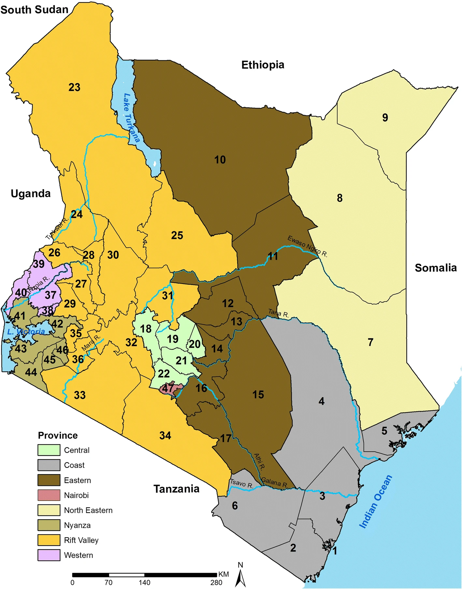
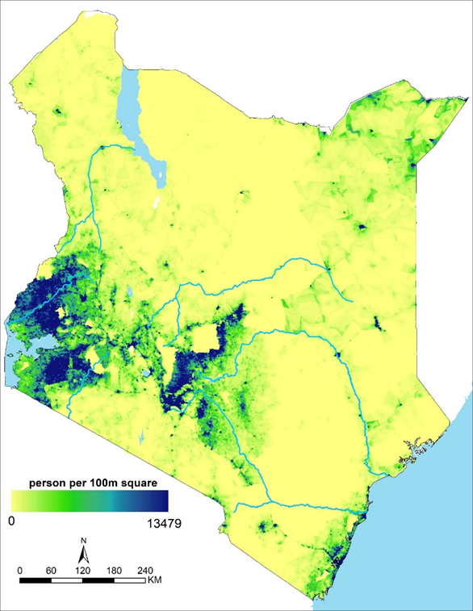

Kenya
Location
Population

Slide 6
Estimation of all cause under five mortality

Slide 7
Spatio-temporal tracking of U5M in Kenya
6 studies
One study on Kenya only
2 at provincial level , 2 at county level and 2 at pixel level
 | Study | Spatial | Temporal
1 | Pezzulo et al 2017 | Province | 2014
2 | Liu et al 2019 | Province | 1990-2015
3 | GBD 2016 | County | 1980-2015
4 | Wakefield et al 2017 | county | 1980-2015
5 | Golding et al 2017 | 5*5 km | 2000, 2005, 2010, 2015
6 | Burke et al 2016 | 10*10 km | 1980s, 1990s, 2000s

Slide 8
Observations from studies conducted in Kenya
More data available than used
Course temporal resolution which may mask drastic changes
Not anchored at decision making units for policy relevance
Enhancing the estimates with covariates , may lead to covariate driven metric, precludes any further analysis due circularity
Progress of subnational units against local and global milestones
Role of determinants on spatio-temporal variability of U5M over time

Slide 9
Data for Child mortality estimation in Kenya
Civil & vital registration systems
Gold standard, incomplete (45%)
Health & demographic surveillance sites
Few, non-representative, health interventions, validation*
Health facility data
Utilization, selective care seeking, record keeping
Census
Suited for county level estimation, Not focused, longer repeat period
Household surveys
Focused, not suited for county level estimation
Collect data as deaths occur
Interview about events in the past

Slide 10
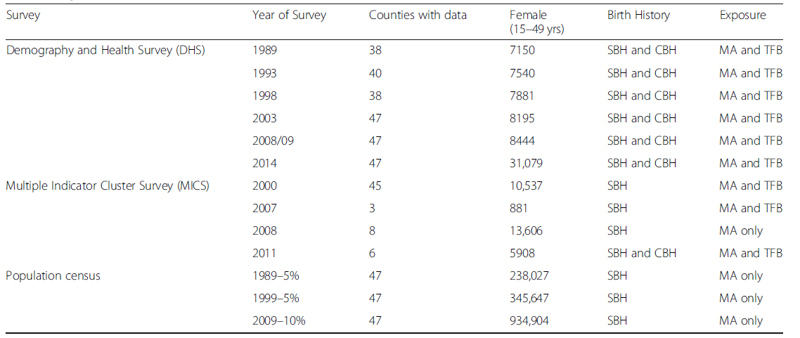
Data assembly and county mapping
Assemble data with birth histories since 1989 in Kenya
Boundary spatial misalignment over time- track changes since 1989
13 surveys 460 county-yrs 1·62 m WoCBA

Slide 11
Demographic modelling of U5M
Complete Birth History (CBH) :
Summary Birth History (SBH):
Date of birth
Survival status (dead/alive)
If dead: age at death
Resource consuming, collected in few surveys. DHS and MICS
Direct methods used to estimate U5M
No. of children born alive (CEB)
Number dead if applicable (CD)
Maternal age, time since first birth
Collected during both during census & surveys
Indirect methods used to estimate U5M
Notes:
http://

Slide 12

Generating Raw U5m
Direct
Cohort: Maternal Age and Time since First Birth Cohorts
Period: Maternal age and Time since First Birth Period
Indirect

Slide 13
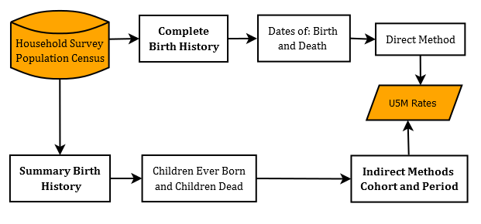
Demographic modelling of U5M

Slide 14
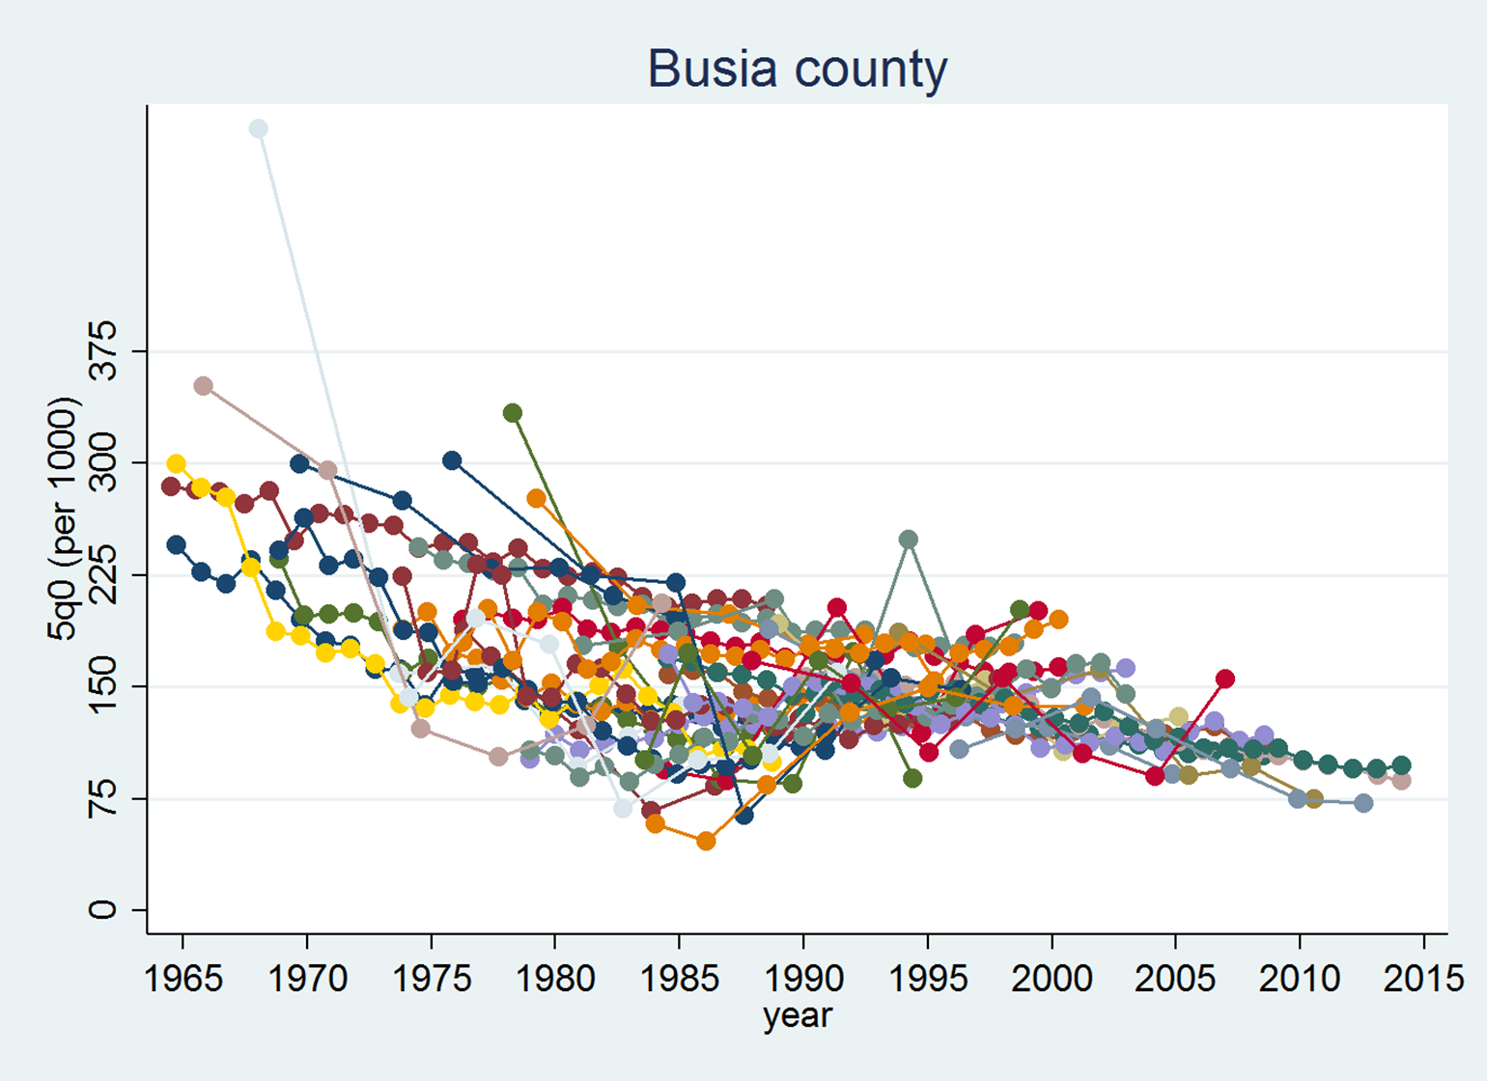
Imprecise U5M rates by county
  Insufficient sample sizes
  Heterogeneity between surveys
  Heterogeneity between demographic techniques
  Spatial and temporal relatedness

Slide 15
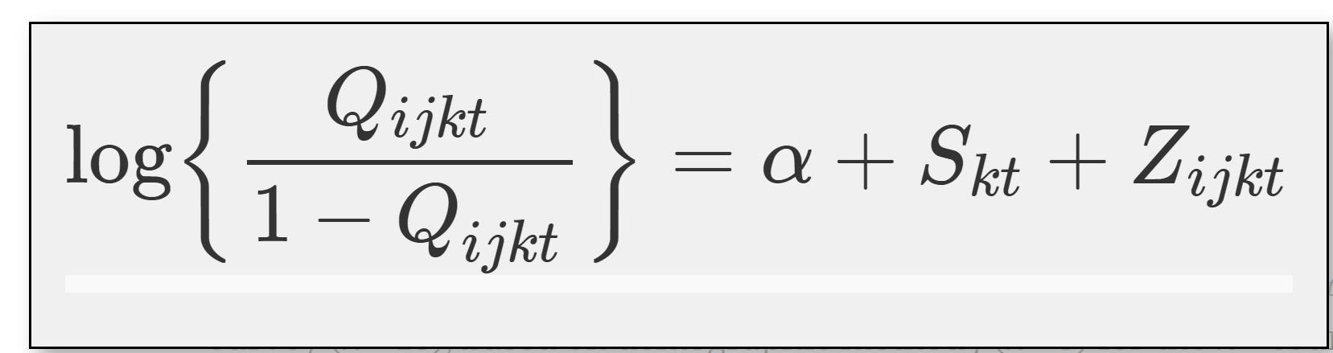
Spatio-temporal modelling
spatio-temporal Gaussian process
With mean 0, and a covariance structure
Space as CAR, Time as RW1
Queen contiguity
Estimated U5M
i^{th} survey, method j, k^{th} county, year t
Gaussian noise
Variance and mean 0
W is a weight equal to the log sample size
T expresses the variability of methods

Slide 16
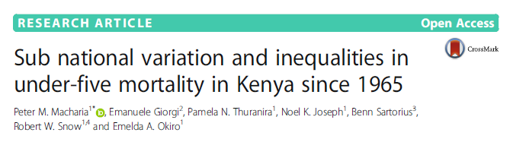


Slide 17
National trend: 62% reduction
ARR 4·5%
Additional vaccines
User fees abolished
ACTs and ITNs, ARVs
Malezi bora, Beyond zero
ARR 1.8%
Economic growth,
Mitigate high fertility
EPI
HIV prevalence
Malaria epidemics
User fees
Resistance to CQ
Poor coverage basic healthcare services
Missed target
Missed target

Slide 18
County level variation
Heterogenous in space and time
1965: 11 counties > 200 & 4 <75
In 2013: 20 counties <50, 3 > 100
High mortality counties with huge declines [range-19-80%]
AAR uneven
Some counties have stagnated in the most recent times
NE with lower rates in most recent period

Slide 19
Inequalities
5 X
3.8X
The bold line shows average change in inequality while considering the extremes

Slide 20
Discussion
1. There is need to address the high levels inequalities
2. Sub optimal achievement of WSC and MDG4 goals
3. Harmonized framework of setting and monitoring goals
4. National level allocation and distribution of health related resources
5. Need to understand drivers of observed patterns by county for a targeted package of intervention tailored to individual contexts.

Slide 21
What might explain the trends?

Slide 22
Framework

Slide 23
Data assembly and county mapping
Surveys | Year | counties | Households | Clusters | Women
DHS | 1989 | 38 | 8,173 | 393 | 7,150
 | 1993 | 40 | 7,950 | 520 | 7,540
 | 1998 | 38 | 8,380 | 536 | 7,881
 | 2003 | 47 | 8,561 | 400 | 8,195
 | 2008/09 | 47 | 9,057 | 400 | 8,444
 | 2014 | 47 | 36,430 | 1,612 | 31,079
MICS | 2000 | 42 | 9,045 | 900 | 10,537
 | 2007 | 3 | 881 | 62 | 881
 | 2008 | 8 | 14,677 | 650 | 13,606
 | 2011 | 6 | 6,828 | 300 | 5,908
 | 2013/14 | 3 | 3,744 | 158 | 3,348
Census | 1989 | 47 | 224,861 | 36,979 | 238,027
 | 1999 | 47 | 317,106 | 61,921 | 345,647
 | 2009 | 47 | 243,858 | - | 934,904
AIS | 2007 | 47 | 9,691 | 402 | 5,991
 | 2012 | 44 | 8,035 | 371 | -
MIS | 2007 | 43 | 6,854 | 200 | 6,111
 | 2010 | 47 | 6,538 | 240 | 5,749
 | 2015 | 47 | 6,481 | 245 | 5,394
WMS | 1994 | 47 | 10,880 | 1,189 | -
 | 1997 | 41 | 10,873 | 1,107 | 2,484
KIHBS | 2005/06 | 47 | 13,390 | 1,339 | 16,446
 | 2015/16 | 47 | 21,773 | 2,387 | 23,768
Assemble data with at least a determinant since 1989 in Kenya
Boundary spatial misalignment over time- track changes since 1989

Slide 24
Smoothing determinants using a binomial model
𝜂_{it} = b₀ + u_{i} + 𝑣_{i} + 𝛾_{t} + 𝜙_{t}+ 𝛿_{it}
Areal level data
Spatially and temporally structured random effect modelled via CAR BYM and RW1 respectively
Unstructured spatial random effects assumed IID
4 interactions tested and discriminated using DIC/WAIC
No covariates
Geostatistical model malaria data

Slide 25
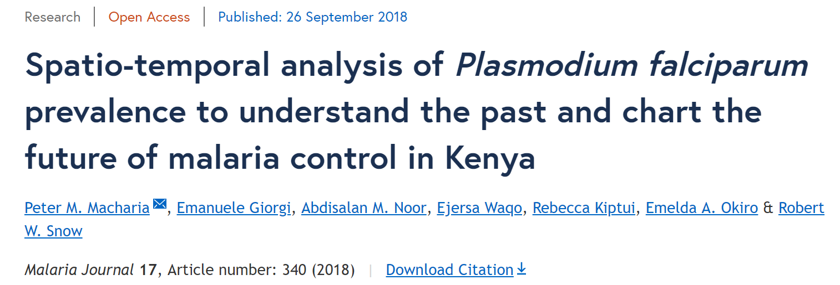
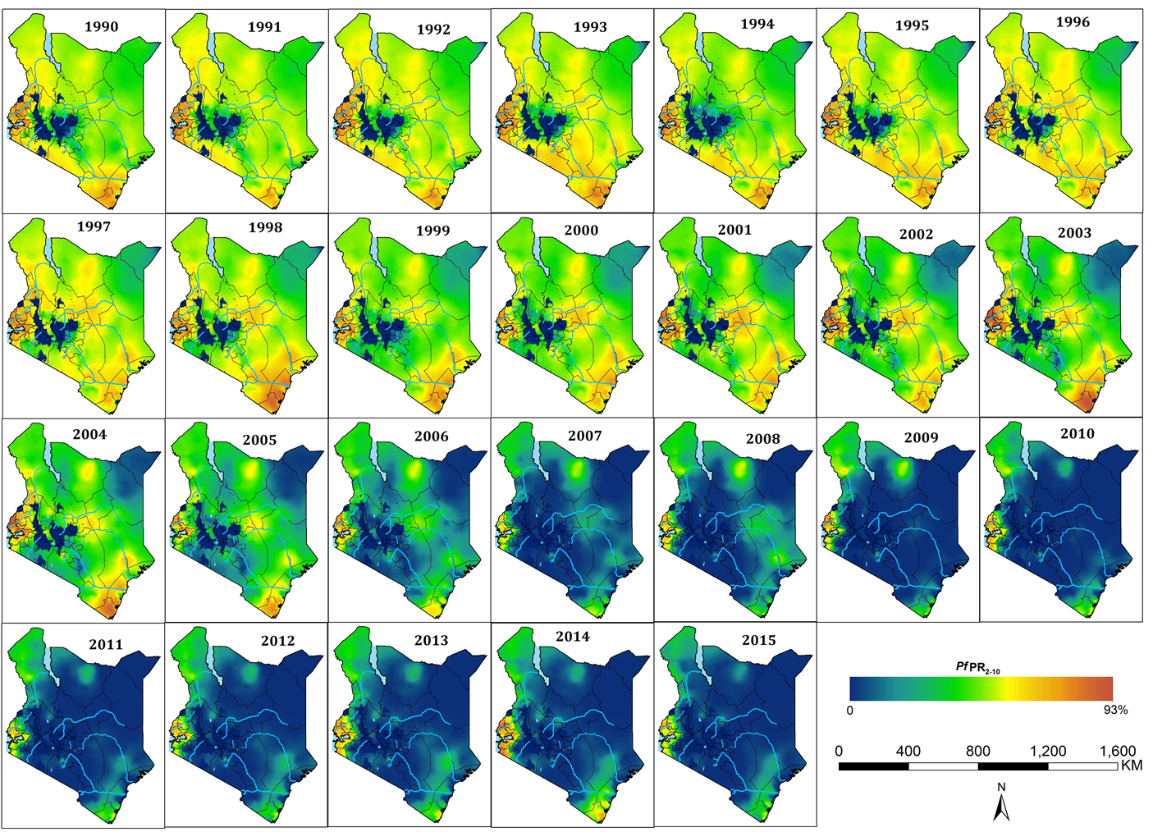

Slide 26
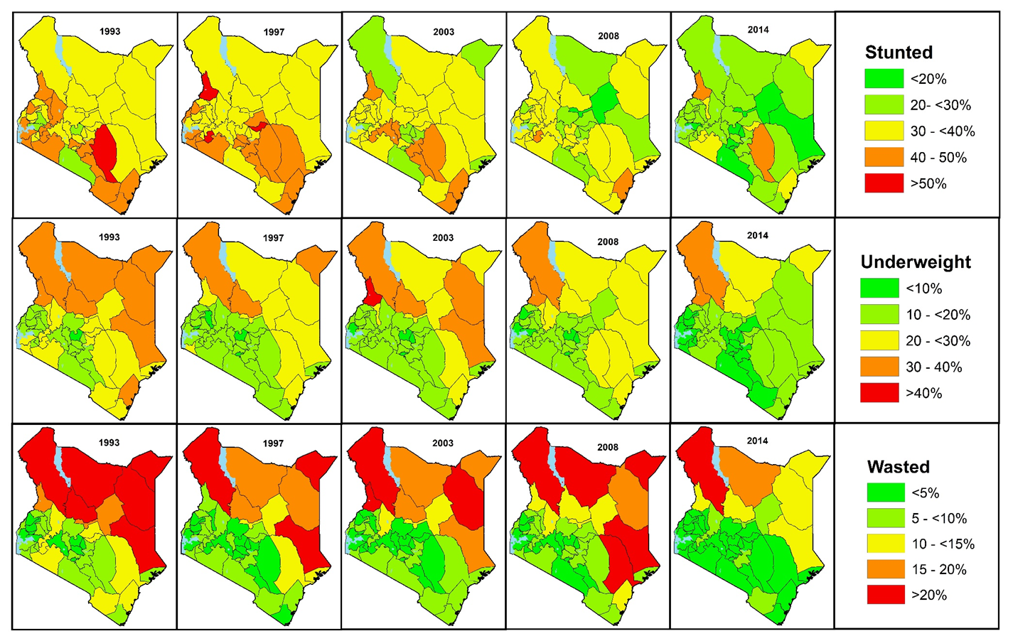
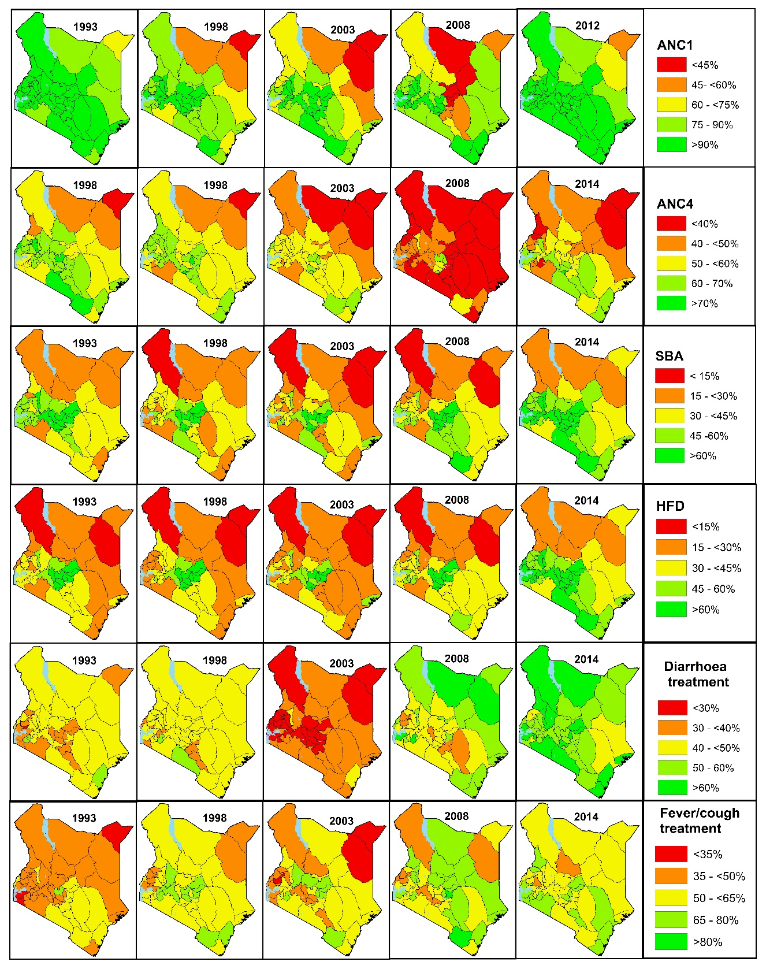
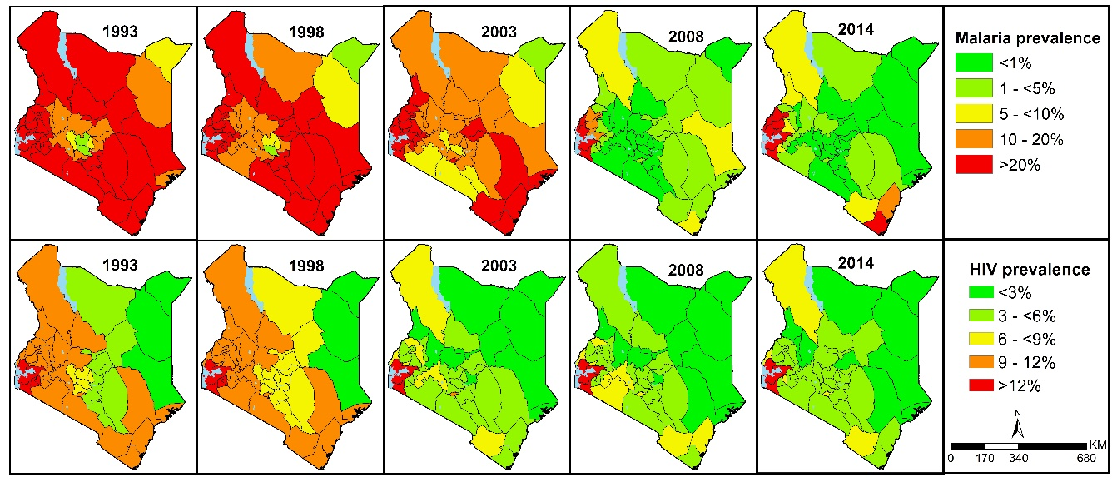
Nutrition status
Health care utilization
Malaria and HIV

Slide 27
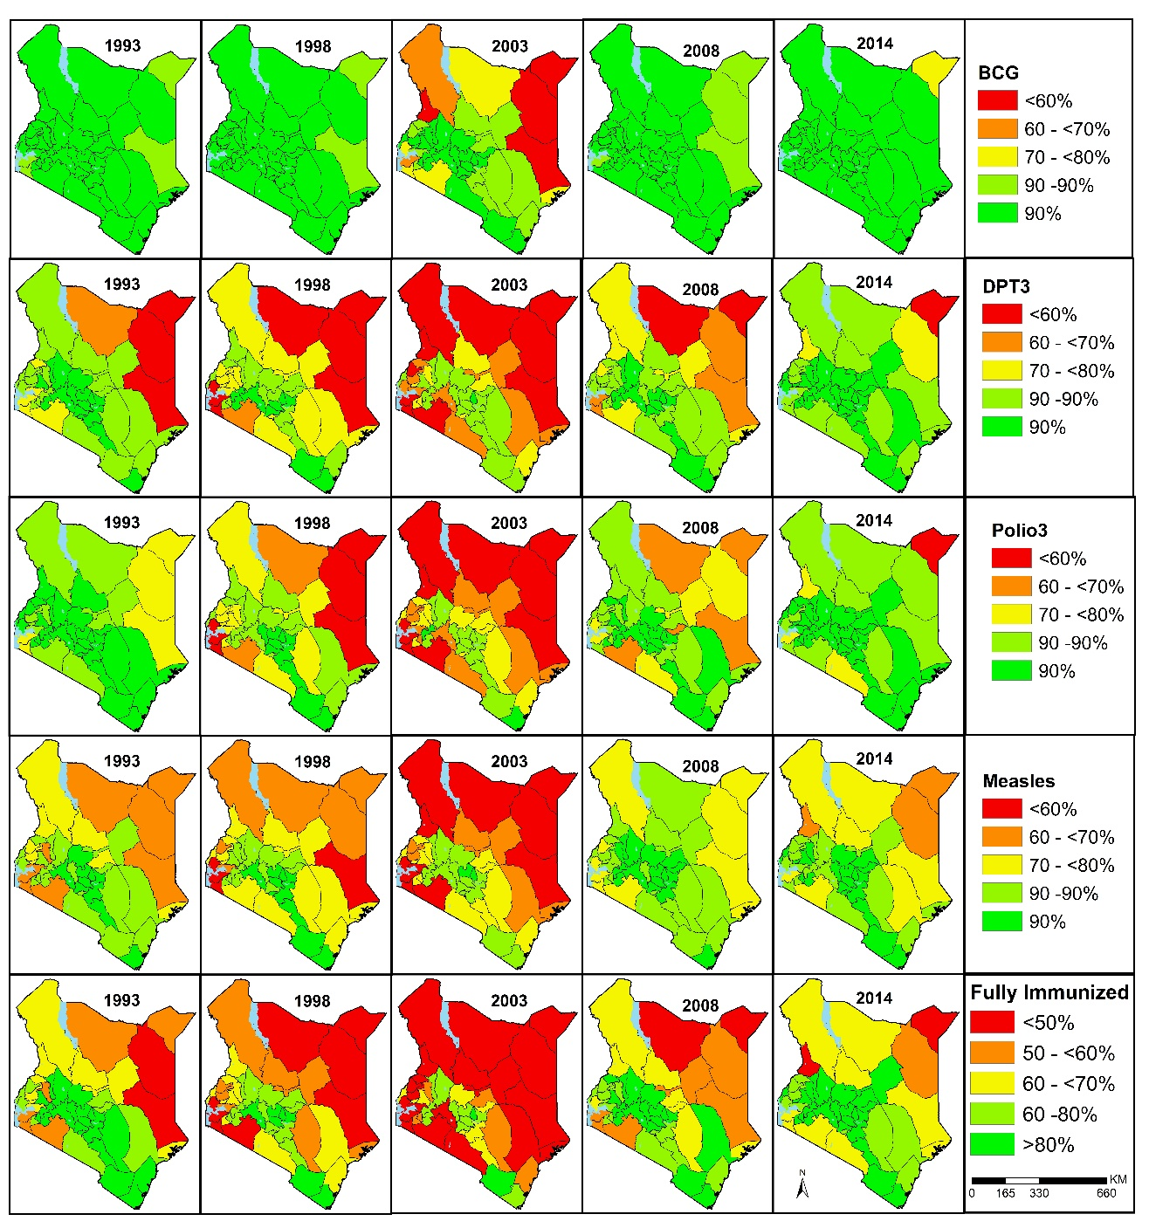
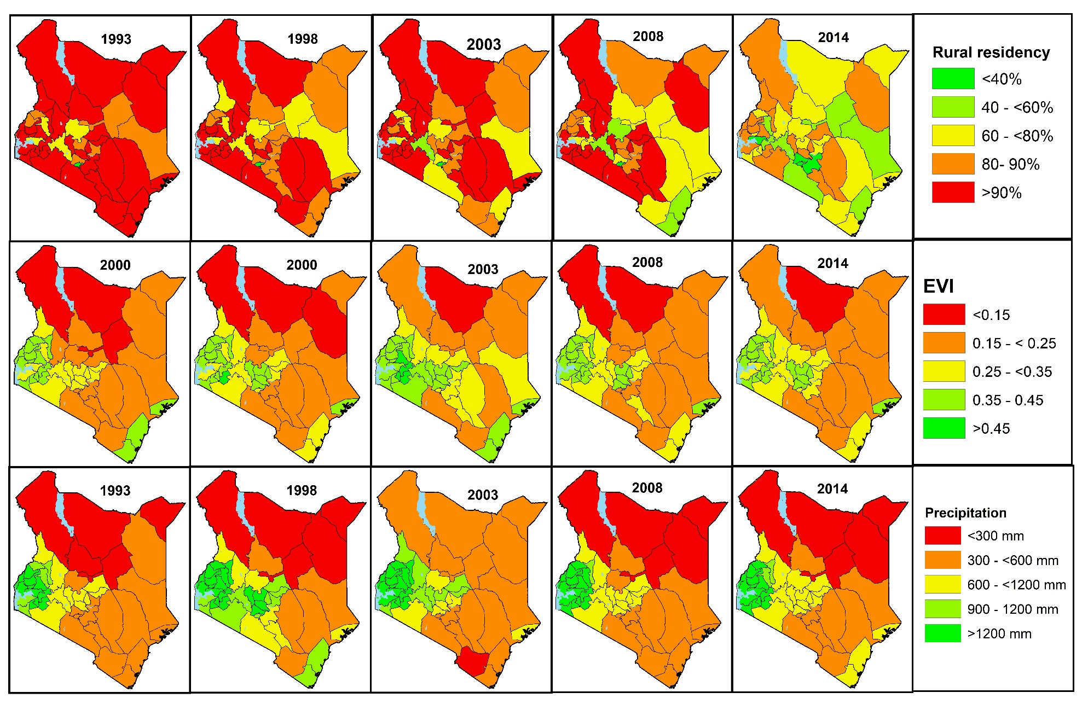
Immuinization
Rainfall and vegetation

Slide 28
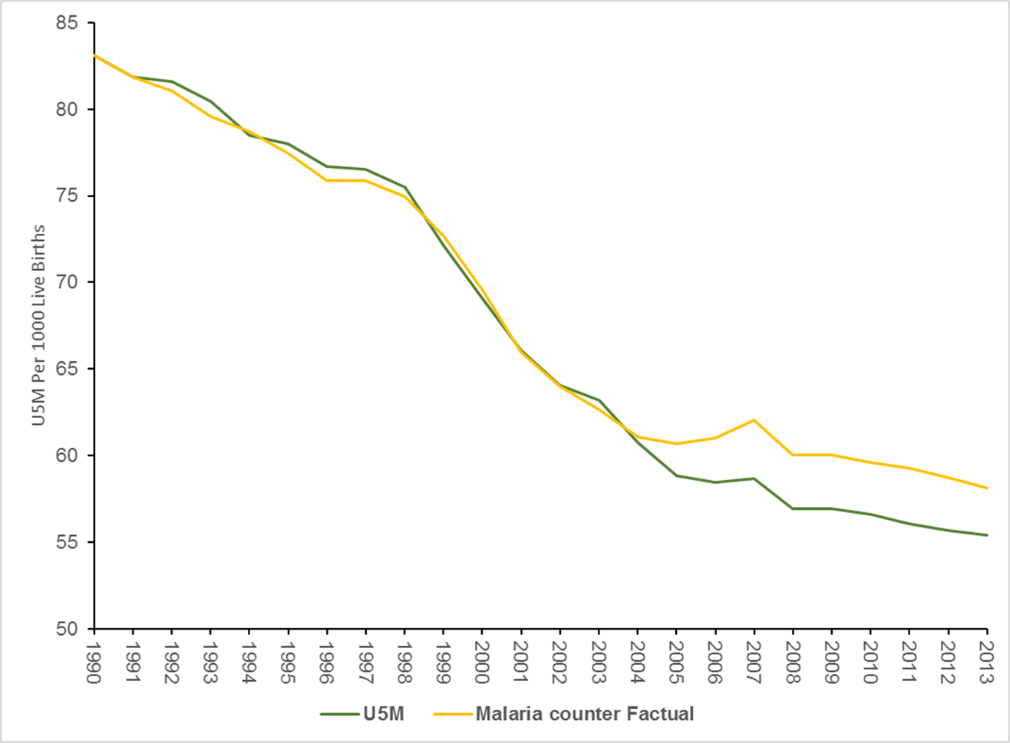
Role or contribution of each determinant
U5M if malaria risk remained unchanged since 1990
Deaths averted due to malaria decline
U5M due to changes in malaria risk

Slide 29


